Slide 1

FOREST FIRE
PREDICTION
FINAL PRESENTATION
GROUP MEMBERS :
AKHIL ARUN - U2208004
ARLEEN ANN SHINU - U2208012
JERIN JAISON - U2208031
MEREES NOBY - U2208044
GUIDE : Dr. Varghese S Chooralil

Slide 2

INTRODUCTION:
Forest fires pose significant environmental risks, leading to the loss of biodiversity, economic damage, and harm to human lives.
Effective prediction and management of forest fires are crucial to mitigating their impact and safeguarding both biodiversity and human communities.
This project focuses on developing a Forest Fire Prediction Website that leverages historical meteorological and geographical data from the UCI Machine Learning Repository

Slide 3

Problem Definition

Slide 4
Forest fires are increasingly frequent due to climate change and human activity.
Existing systems lack real-time, accessible tools for early fire risk prediction.
Manual data analysis is time-consuming and not scalable for large regions.
There's a need for a web-based platform that:
Collects user/environmental inputs (temperature, FMC, wind speed, etc.)
Predicts fire occurrence and severity using machine learning models
Displays results in a user-friendly interface for quick decision-making

Slide 5
Literature Review

Slide 6
Title of Paper, Authors | Journal / Conference | Year | Technologies / Algorithms Used | Advantages / Features | Limitations
 |  |  |  | High Predictive Accuracy Low Error Rates Applicable in early warning systems Focus on real world relevance | Lack of advanced deep learning models Simplistic PreProcessing Techniques Model Generalizability Validation Gaps
Riau Forest Fire Prediction using Supervised Machine Learning B S Negara, R Kurniawan, M Z A Nazri, S N H S Abdullah, R W Saputra | Journal of Physics: Conference Series, Volume 1566, 4th International Conference on Computing and Applied Informatics | 2020 | Decision Tree Bayesian Network

Slide 7
Title of Paper, Authors | Journal / Conference | Year | Technologies / Algorithms Used | Advantages / Features | Limitations
 |  |  |  | Adaptive and hybrid ML models demonstrated improved mapping accuracy. Future predictions for FFS trends (2022–2100) using climate scenarios Incorporation of 44 influencing factors categorized into topographic, climate-hydrologic, vegetation indices, radar features, and anthropogenic parameters. | Specific to the Similipal Tiger Reserve (STR), limiting wider geographic applicability. Computationally intensive due to the inclusion of 44 independent variables. Data-specific time constraints may affect long-term model relevance (e.g., climatic changes).
Integrating Geospatial, Remote Sensing, and Machine Learning for Climate-Induced Forest Fire Susceptibility Mapping in Similipal Tiger Reserve, India The authors are: Kishore Chandra , Armin Moghimi | Forest Ecology and Management | 2024 | Geographical Information Systems (GIS) Remote Sensing (RS) Cloud-based platforms (e.g., Google Earth Engine) Algorithms Used: Random Forest (RF)-Standard decision-tree-based ensemble method for classification. Neural Net (nnet)A feed-forward artificial neural network using the perceptron architecture and backpropagation.

Slide 8
Title of Paper, Authors | Journal / Conference | Year | Technologies / Algorithms Used | Advantages / Features | Limitations
 |  | 2024
Machine Learning based Forest Fire Prediction: A Comparative Approach
Rohini Patila, Janhvi Pawara, KamalShahb, Disha Shettya, Aparna Ajitha, Sakshi Jadhava
"International Research Journal of Multidisciplinary Technovation" (IRJMT)
Volume 6, Issue 1
Logistic Regression,
Random Forest,
Support Vector Classifier,
Decision Tree,
K Nearest Neighbors
Comprehensive Model Evaluation
Incorporation of Optimization Techniques
Use of Real-World Data
Dataset-Specific Performance
Computational Demands
Feature Dependence

Slide 9
Title of Paper, Authors | Journal / Conference | Year | Technologies / Algorithms Used | Advantages / Features | Limitations
 |  |  |  | Hazard Mapping Kernel Density Estimation (KDE) Focus on Human and Environmental Factors High Predictive Accuracy Comparative Model Evaluation Fire prevention and Economic impact | Lack of Long-Term Fire Data Lack of Temporal Dynamics Challenges with Certain Models
Forest Fire Prediction: A Spatial Machine Learning Approach The authors are: Sanjeev Sharma Puskar Khanal | The paper was published in the journal Fire, Volume 7, Issue 6, in 2024. . | 2024 | Decision Tree (DT) Random Forest (RF) Python 3.11 Google Earth Engine Correlation Coefficient Analysis Kernal Density Estimation

Slide 10
Module Division :

Slide 11
User Interface Module
Technologies: HTML, CSS, JavaScript
Function: Collects input data (temperature, FMC, wind, etc.) and displays predictions
visually.
Data Preprocessing Module
Techniques: Data normalization, missing value handling, feature selection
Purpose: Cleans and prepares input data for ML models to improve accuracy.

Slide 12
Prediction Module
Algorithms Used:
XGBoost Classification – for predicting fire occurrence
Random Forest Regression – for predicting fire severity
Function: Generates fire risk predictions based on processed inputs.
Backend & API Module
Technologies: Python (Flask), REST API
Function: Handles communication between frontend and ML model, returns prediction results.

Slide 13
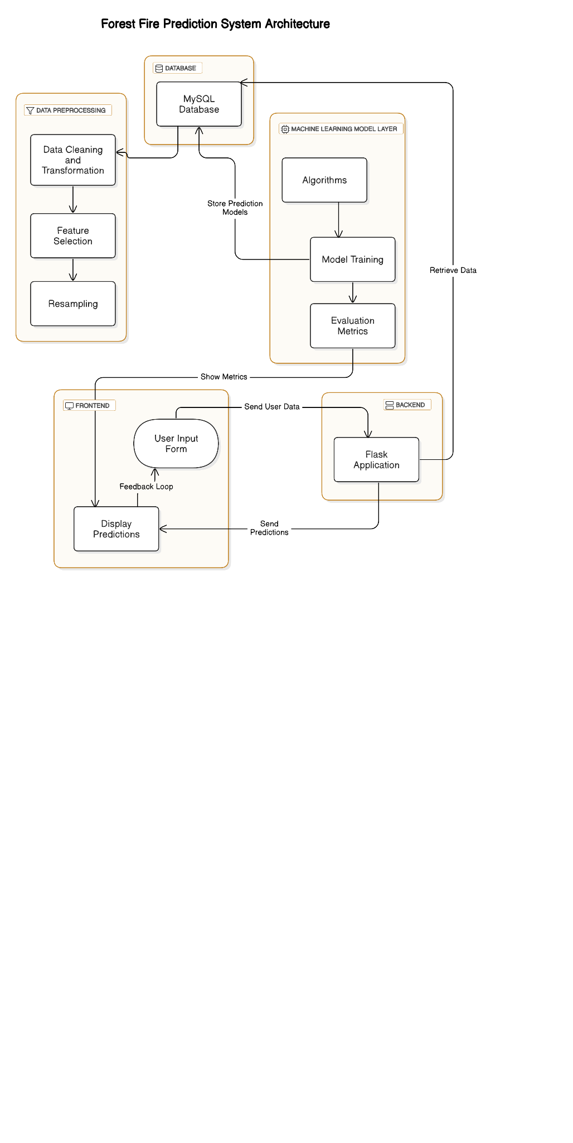
System
Architecture

Slide 14
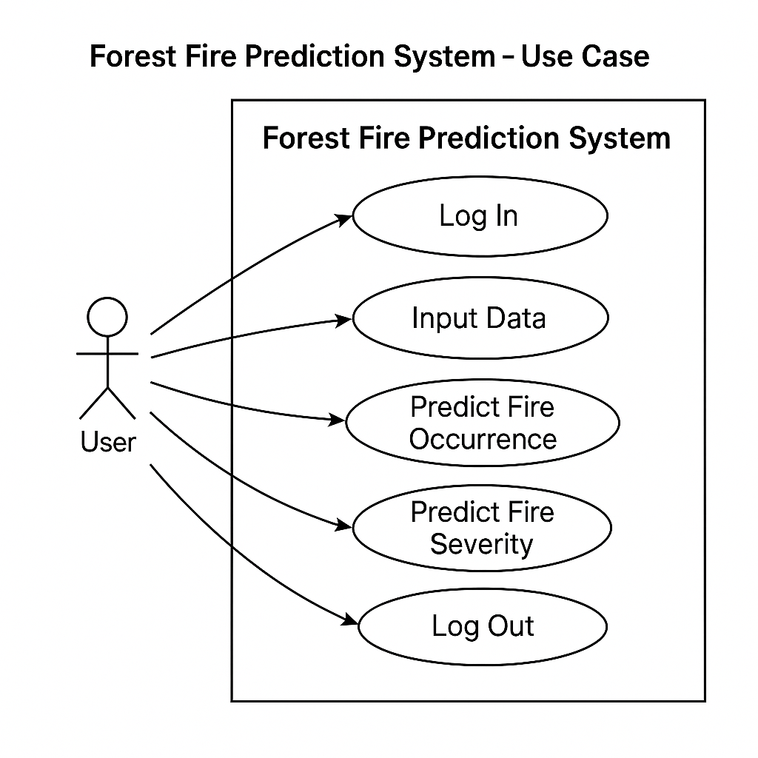
Use Case
Diagram

Slide 15
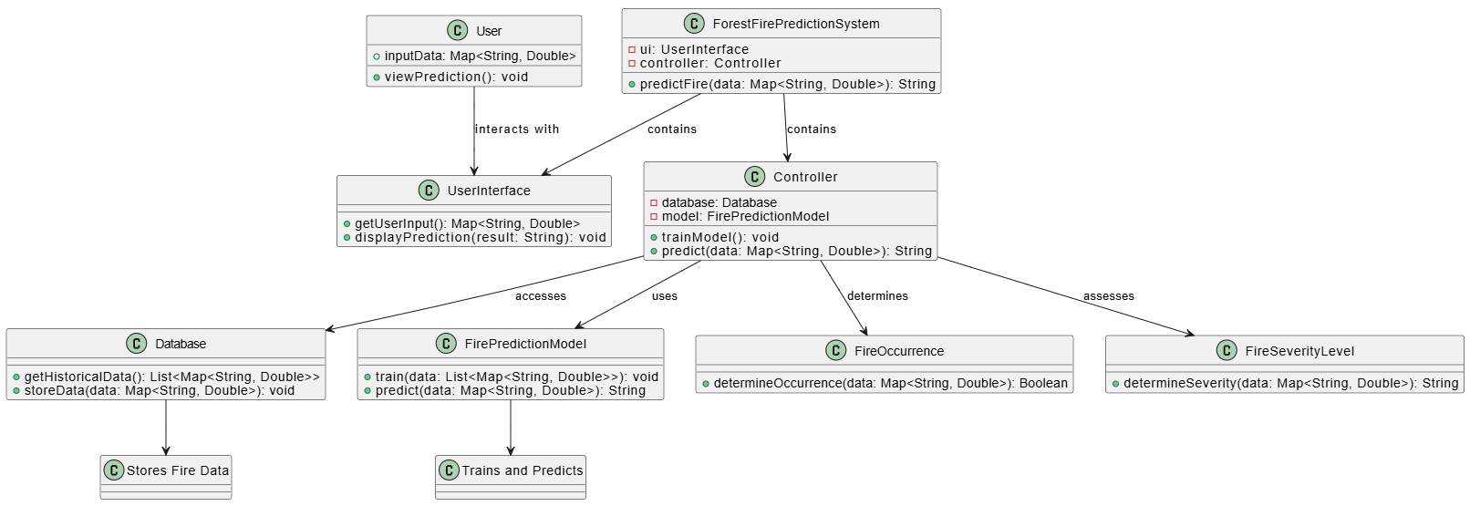
Class Diagram

Slide 16
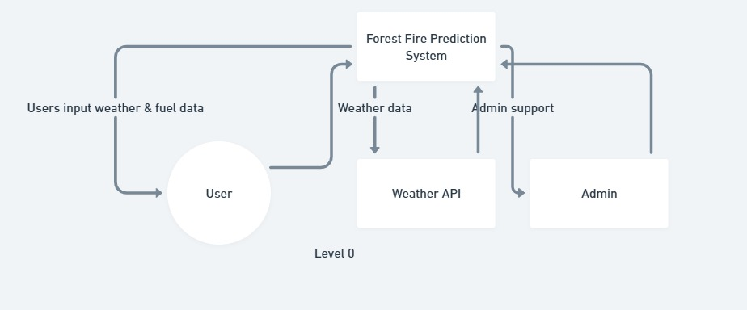
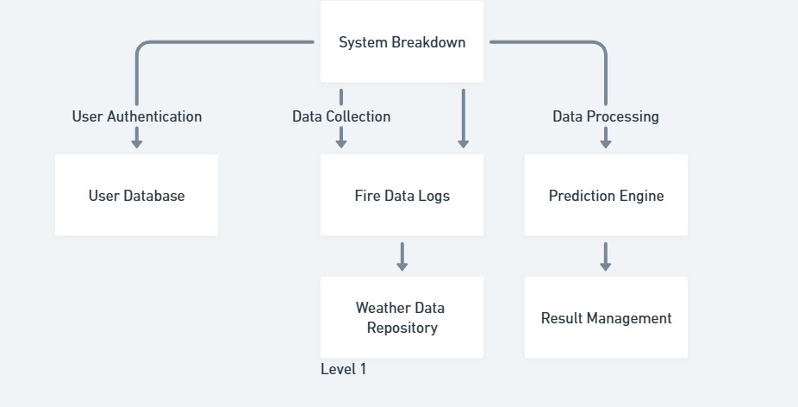
DFD

Slide 17
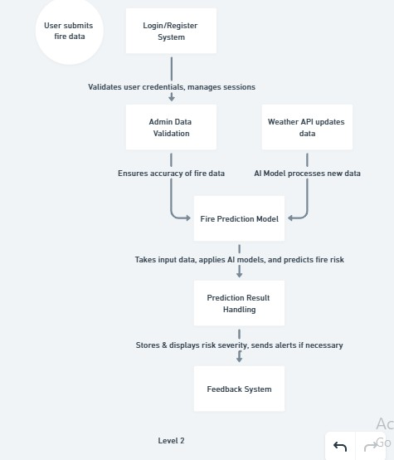
DFD

Slide 18
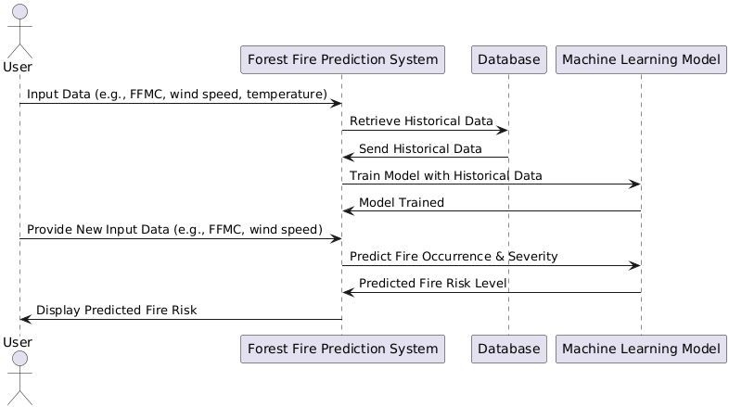
Sequence Diagram

Slide 19
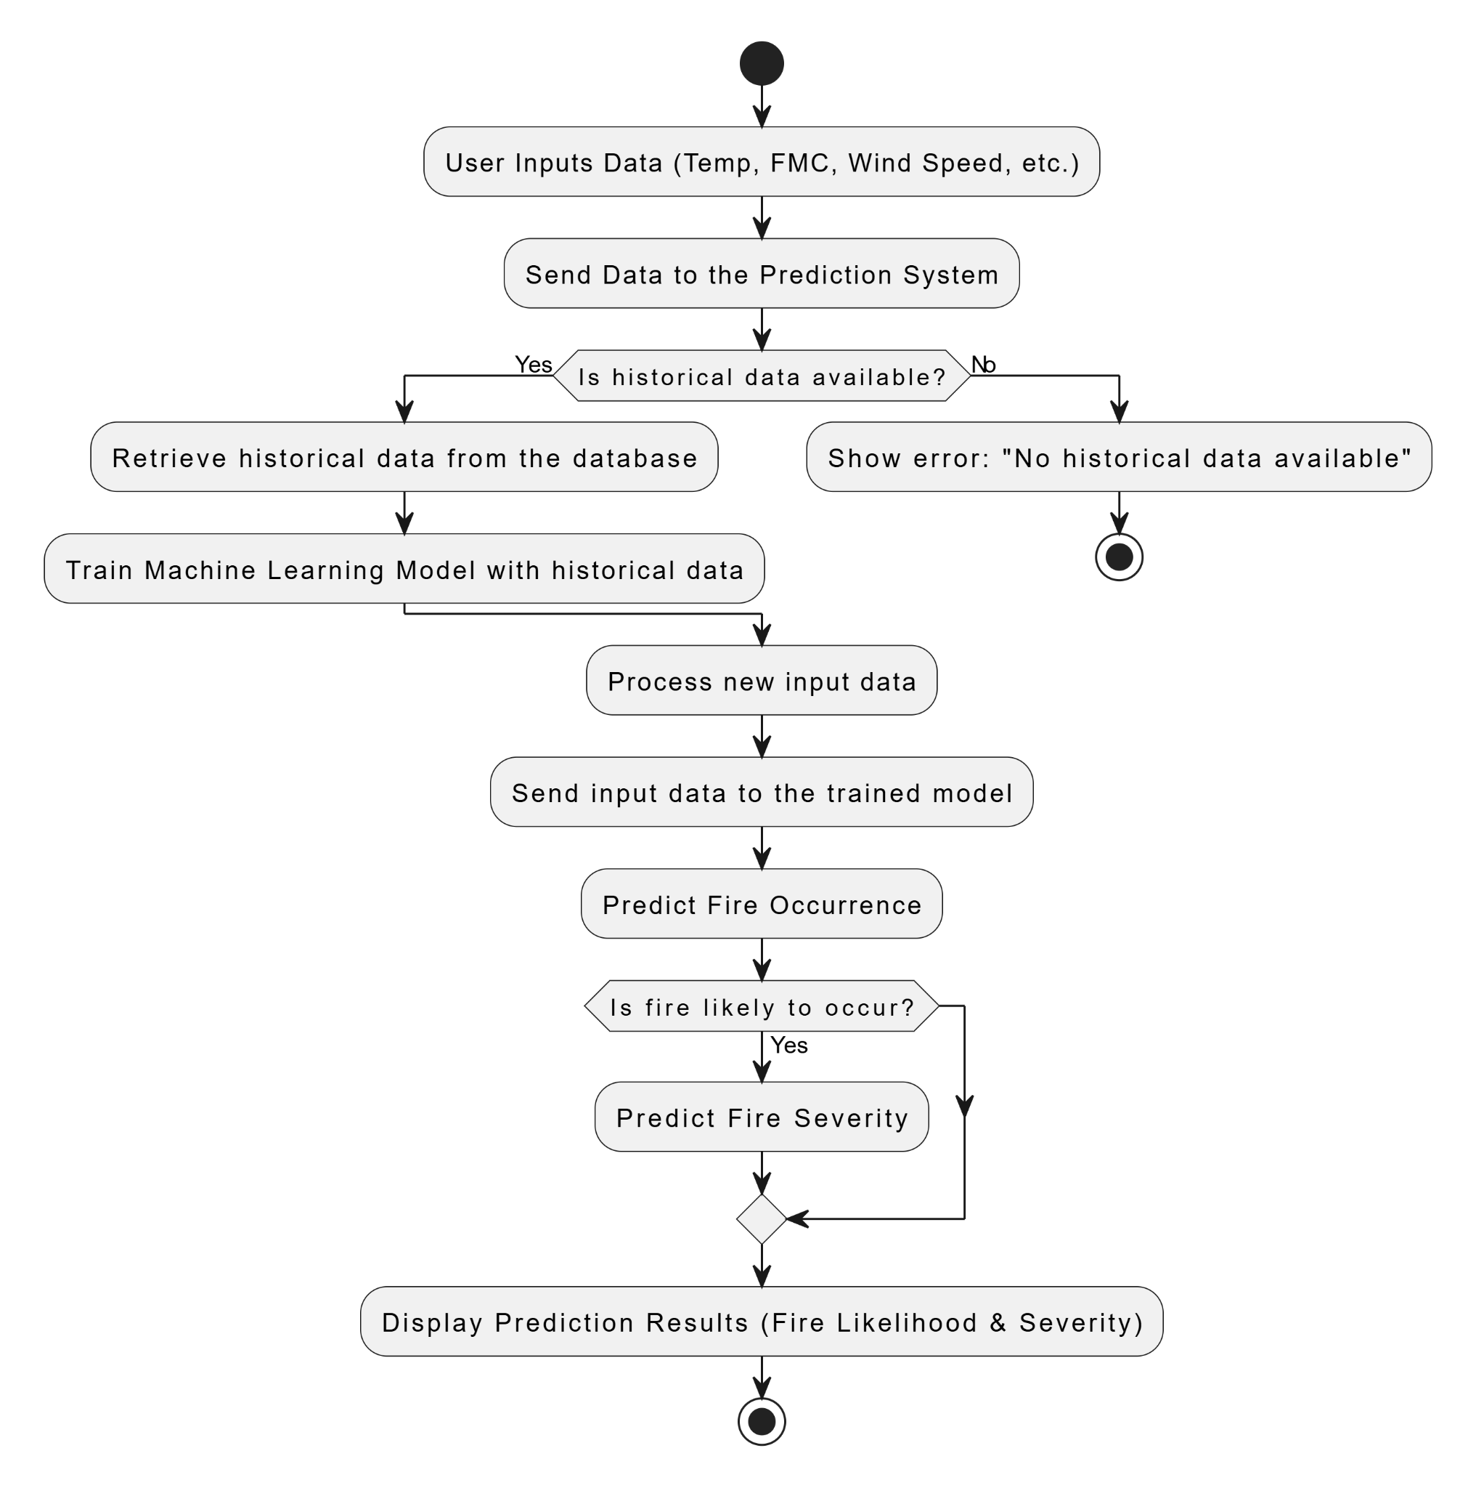
Activity Diagram

Slide 20
Output

Slide 21


Slide 22
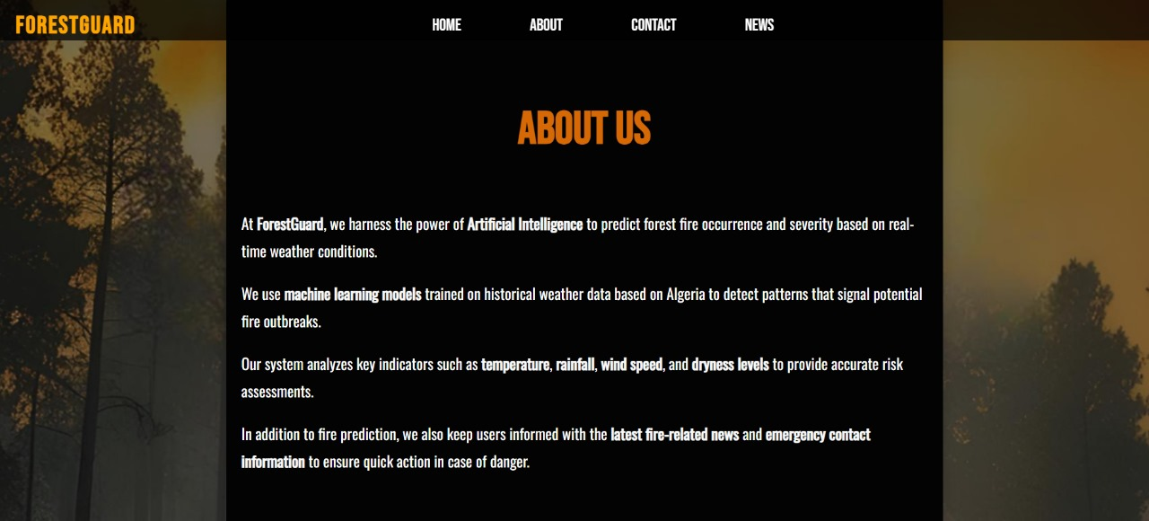

Slide 23
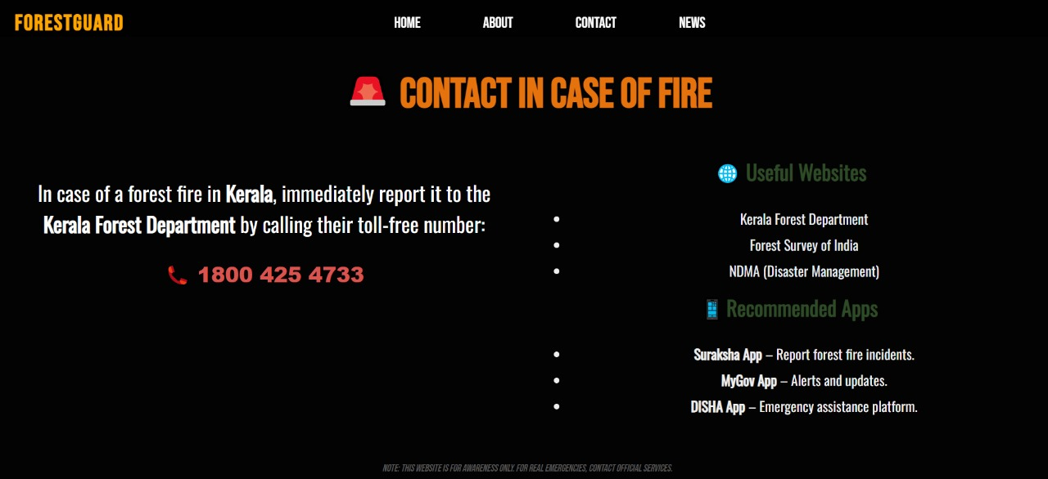

Slide 24
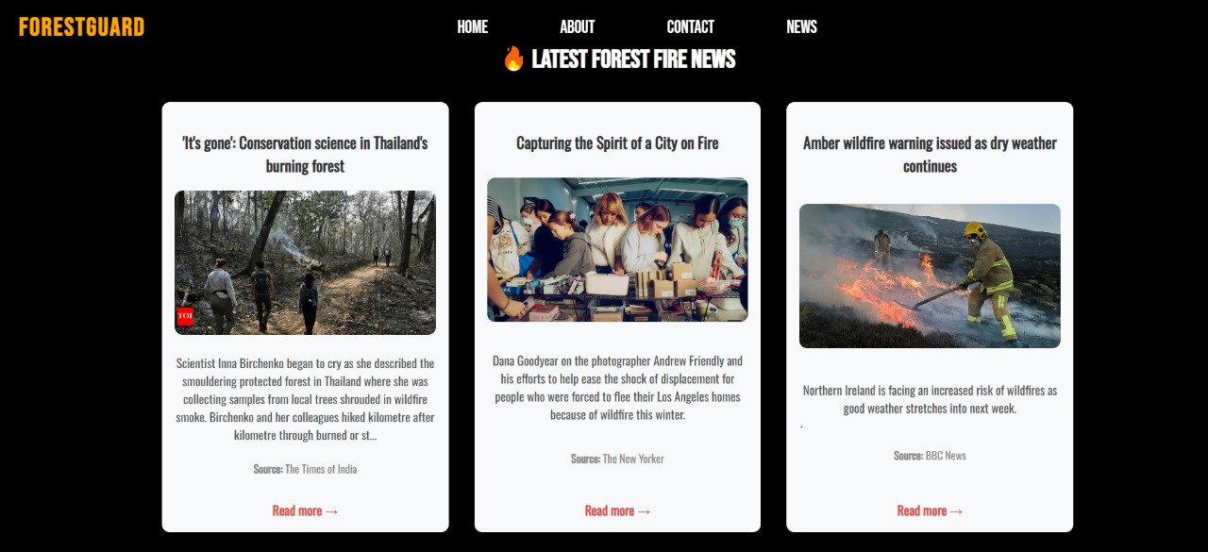

Slide 25
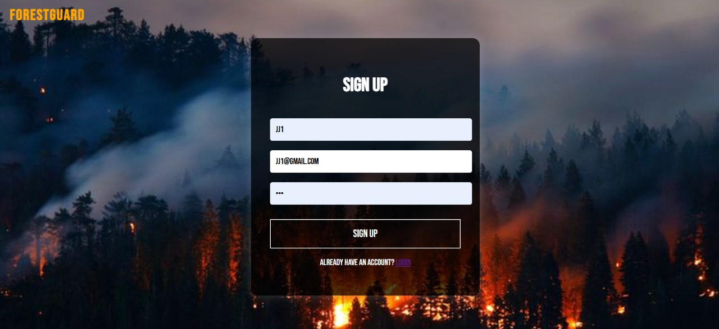

Slide 26
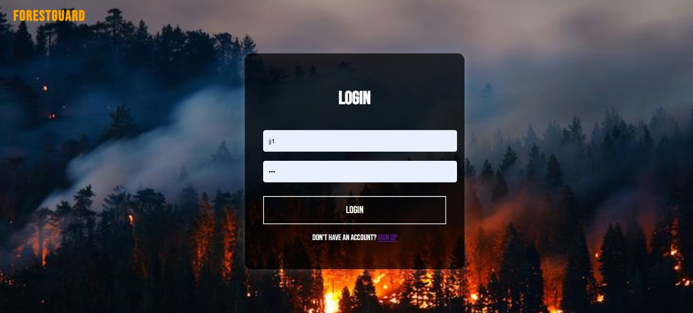

Slide 27
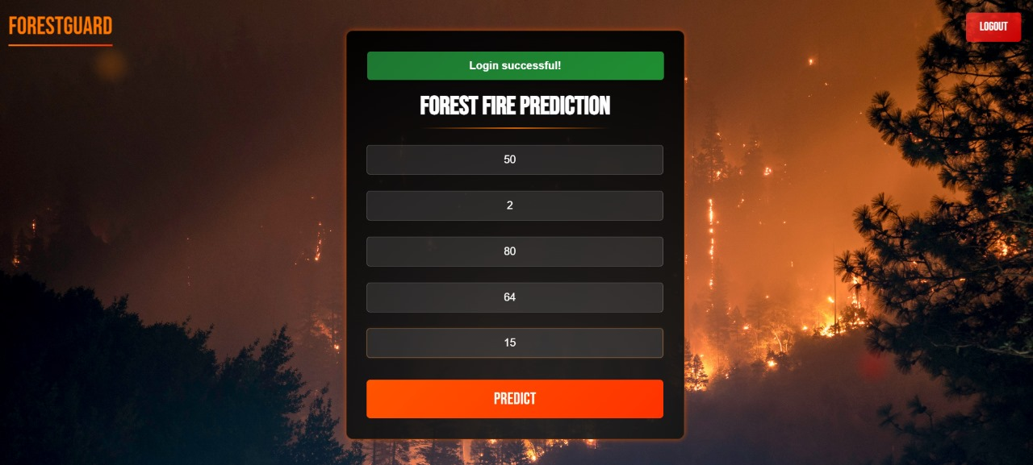

Slide 28
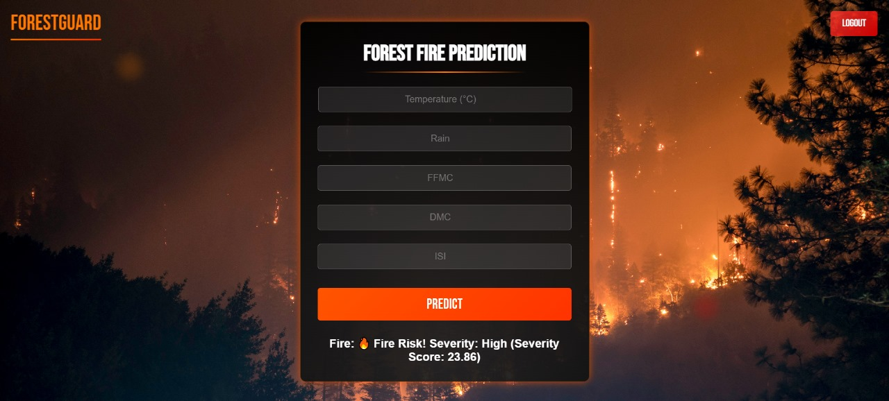

Slide 29
Hardware Requirements
Processor : AMD Ryzen 7
Ram : 16GB
Storage : 1TB
Network : 100 Mbps Lan/ Wifi
Software Requirements
Operating System : Windows 11
Frontend : HTML, CSS
Backend : Flask
Database : NoSQL JSON database

Slide 30
Future Scope

Slide 31
Mobile App Development
Cross-platform app (Flutter/React Native).
Field data input, real-time predictions, and alert system.
Cloud Deployment
Host system on AWS/GCP with scalable architecture.
Use REST APIs and containers for modular growth.
Government & Research Collaboration
Access real-time forest and satellite data.
Support early warning systems and policy-making.

Slide 32
IoT Integration
Use sensors for real-time temperature, humidity, wind, FMC data.
Enables live monitoring and hyper-local predictions.
Deep Learning Models
Apply CNN + LSTM for spatial-temporal prediction.
Enhance accuracy using satellite imagery and time-series data.

Slide 33
References :

Slide 34
R. Patil, A. Kulkarni, and P. Deshmukh, "Machine Learning Based Forest Fire Prediction: A Comparative Approach," International Research Journal of Modernization in Technology and Engineering (IRJMT), vol. 6, no. 1, 2021.
L. Breiman, "Random Forests," Machine Learning, vol. 45, no. 1, pp. 5–32, 2001.
T. Chen and C. Guestrin, "XGBoost: A Scalable Tree Boosting System," in Proceedings of the 22nd ACM SIGKDD International Conference on Knowledge Discovery and Data Mining, San Francisco, CA, 2016, pp. 785–794.
UCI Machine Learning Repository, "Forest Fire Dataset," University of California, Irvine, 1998.
Scikit-learn Developers, "Scikit-learn: Machine Learning in Python," Journal of Machine Learning Research, vol. 12, pp. 2825–2830, 2011.
Flask Developers, "Flask: A Python Microframework," Pallets Projects, 2010.

Slide 35
Conclusion
A Forest Fire Prediction System is developed using HTML & CSS for the frontend to ensure a simple and interactive user interface, while Flask is used in the backend for smooth data flow management and user interaction. The AI model integrates XGBoost Classifier for predicting fire occurrence and Random Forest Regressor for severity prediction, utilizing environmental, historical, and geographical data for better accuracy.
Future enhancements include real-time forest and satellite data integration, an automated alert system, deployment of sensors for live environmental data collection, and a fully functional web application for real-time monitoring and fire prevention. This system will help improve forest safety, early detection, and effective disaster management.

